Slide 1
Object Oriented Programming Lecture 9

Slide 2
Example
class Student {
int id=123;
public static void main(String[] args) {
Student s1= new Student();
System.out.print(s1.id);
}
}
Output : 123

Slide 3
Example
class Student {
int id=123;
public void showRecord(){
System.out.println(id);
}
public static void main(String[] args) {
Student s1= new Student();
s1.showRecord();
}
}
Output:123

Slide 4
Variable shadowing
Shadowing refers to the practice in Java programming of using two variables with the same name within scopes that overlap. When you do that, the variable with the higher-level scope is hidden because the variable with lower-level scope overrides it. The higher-level variable is then “shadowed.”

Slide 5
Example
public class testShadow {
int a=1;
public void test()
{
System.out.println(a);
}
public static void main(String[] args) {
testShadow t= new testShadow();
t.test();
}
}
Output:1

Slide 6
shadowing
public class testShadow {
int a=1;
public void test()
{
int a=5;
System.out.println(a);
}
public static void main(String[] args) {
testShadow t= new testShadow();
t.test();
}
}
Output : 5

Slide 7
Using this keyword
public class testShadow {
int a=1;
public void test()
{
int a=5;
System.out.println(this.a);
}
public static void main(String[] args) {
testShadow t= new testShadow();
t.test();
}
}
Output:1

Slide 8
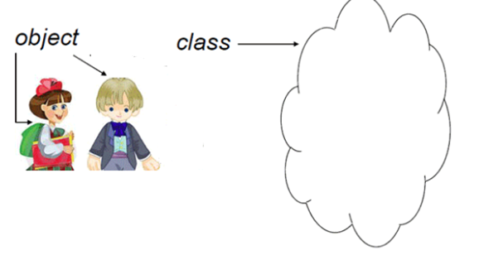
class Student {
int id;
String name;
String gender;
public void showRecord(){
System.out.println(id +" "+name+" "+gender );
}
public void insertRecord(int recId, String recName, String recGender){
id= recId;
name=recName;
gender=recGender;
}
public static void main(String[] args) {
Student s1= new Student();
Student s2= new Student();
s1.insertRecord(123,"Junaid","Male");
s2.insertRecord(456,"kiran","Female");
s1.showRecord();
s2.showRecord();
}
}
Student
Id
Name
gender
123 Junaid Male
456 Kiran Female

Slide 9
class Student {
int id;
String name;
String gender;
public void showRecord(){
System.out.println(id +" "+name+" "+gender );
}
public void insertRecord(int id, String name, String gender){
id= id;
name=name;
gender=gender;
}
public static void main(String[] args) {
Student s1= new Student();
Student s2= new Student();
s1.insertRecord(123,"Junaid","Male");
s2.insertRecord(456,"kiran","Female");
s1.showRecord();
s2.showRecord();
}
Output
0 null null
0 null null
Student
Id
Name
gender

Slide 10
class Student {
int id;
String name;
String gender;
public void showRecord(){
System.out.println(id +" "+name+" "+gender );
}
public void insertRecord(int id, String name, String gender){
this.id= id;
this.name=name;
this.gender=gender;
}
public static void main(String[] args) {
Student s1= new Student();
Student s2= new Student();
s1.insertRecord(123,"Junaid","Male");
s2.insertRecord(456,"kiran","Female");
s1.showRecord();
s2.showRecord();
}
123 Junaid Male
456 Kiran Female

Slide 11
This
class StudentDemo {
public void fun(){
System.out.print(this);
}
public static void main(String[] args) {
StudentDemo s1= new StudentDemo();
System.out.print(s1);
s1.fun();
}
}
StudentDemo@1764be1
StudentDemo@1764be1

Slide 12
Return
class StudentDemo {
public StudentDemo fun(){
return this;
}
public static void main(String[] args) {
StudentDemo s1= new StudentDemo();
System.out.println(s1);
System.out.println(s1.fun());
}
}
StudentDemo@1ef9f1d
StudentDemo@1ef9f1d

